Slide 1


Manual CNN Assignment Presentation
ITAI 1378 Computer Vision in Artificial Intelligence
Professor Patricia McManus
Group 4:
Hisham D Macaraya
Katherine Stanton
Dallas Foster
Kaire Campomanes
Elijah Ghaya

Slide 2

Introduction to Convolutional Filters
This presentation covers the concept of applying convolutional filters to images to understand how convolutional neural networks (CNNs) detect different features. The focus is on manual application of vertical, horizontal, and diagonal edge filters on a simple cross pattern. This step-by-step demonstration helps illustrate how CNNs recognize important features like edges, which are crucial for understanding visual data.

Slide 3
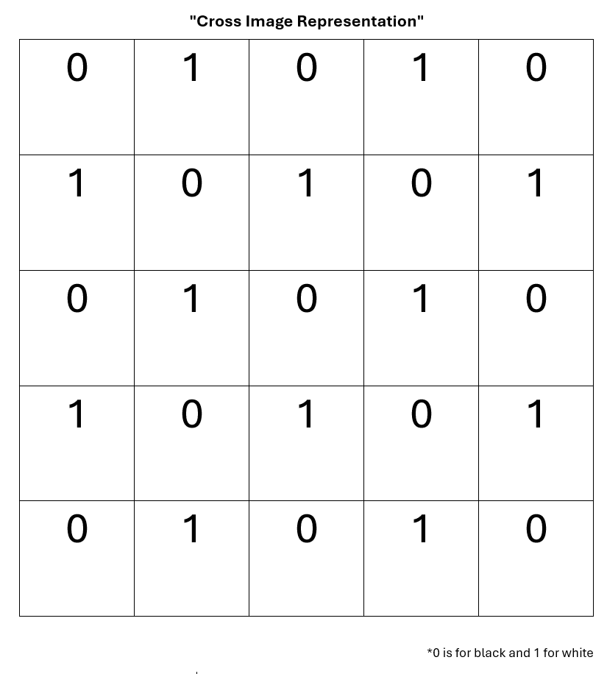
Cross Image Representation
The image is represented by a 5x5 grid with values (0 for black and 1 for white). The cross pattern contains both vertical, horizontal, and diagonal components, making it an ideal subject for testing different types of filters. The pattern is designed to demonstrate how different filters react to various features within an image, helping to highlight the strengths and limitations of each filter.

Slide 4

Introduction to Edge Filters
In this section, we introduce three types of filters used for detecting specific features within an image: the Vertical Edge Filter, the Horizontal Edge Filter, and the Diagonal Edge Filter. Each filter has a specific structure that makes it sensitive to certain patterns. The filters work by emphasizing differences in pixel values in their respective directions, making them powerful tools for identifying edges and other prominent features.

Slide 5
Vertical Edge Filter Application
The Vertical Edge Filter is designed to detect vertical edges by highlighting strong contrasts along the vertical axis. This filter is particularly useful for identifying vertical structures in images, such as buildings or trees. It works by assigning negative values to the left side, positive values to the right side, and zero in the middle, thus detecting changes in intensity along vertical lines (Howard & Gugger, 2020).

Slide 6
Horizontal Edge Filter
The Horizontal Edge Filter is designed to detect horizontal edges by emphasizing differences along the horizontal axis. This filter is effective for identifying features like the horizon or layers in a landscape. It works by assigning negative values to the top row, positive values to the bottom row, and zeros in the middle, enabling it to detect changes in intensity along horizontal lines (Howard & Gugger, 2020).

Slide 7
Diagonal Edge Filter
The Diagonal Edge Filter is used to detect diagonal patterns, which are often present in more complex shapes and structures. Diagonal edges are more challenging to detect because they involve both horizontal and vertical components. This filter assigns mixed positive, negative, and zero values in a way that makes it sensitive to diagonal contrasts, helping to capture features like diagonal edges in the cross pattern (Howard & Gugger, 2020).

Slide 8
Vertical Edge Filter Application
The vertical edge filter is designed to detect vertical lines by emphasizing differences along the vertical axis. When this filter is applied to the cross image, the resulting output grid shows all zeros. This indicates that no significant vertical features were detected. The reason for this is that the cross pattern does not contain distinct vertical edges that align well with the filter structure. The vertical filter looks for strong contrasts along the vertical axis, and in the cross image, the alternating pattern does not provide the necessary contrast to yield a non-zero output.
How the Output Was Obtained: To calculate the output, the filter was manually slid across the 5x5 cross image. At each position, we performed element-wise multiplication between the filter and the overlapping section of the image, followed by summing the results. Since no strong vertical contrasts existed in the image, all resulting values were zero.

Slide 9
Horizontal Edge Filter Application
The resulting output grid is also all zeros, indicating that no significant horizontal features were detected. This is because the cross pattern does not have prominent horizontal lines that align with the filter's structure. The horizontal filter is specifically tuned to detect strong contrasts along horizontal lines, but the cross pattern's mixed nature results in a lack of such contrasts, leading to an all-zero output.
How the Output Was Obtained: The filter was manually convolved across the 5x5 cross image, and for each 3x3 segment, element-wise multiplication was performed, followed by summation. Since there were no strong horizontal features that matched the filter, the resulting output was all zeros.

Slide 10
Diagonal Edge Filter Application
The resulting output grid contains multiple non-zero values, indicating the presence of diagonal features in the cross pattern. This aligns well with the visual structure of the cross, which has strong diagonal intersections effectively detected by the filter. The non-zero values in the output indicate regions where the filter found a match, showing that the diagonal components of the cross pattern are well captured by this filter. This demonstrates the effectiveness of the diagonal filter in detecting features that run along diagonal axes, which are often more challenging to detect compared to vertical or horizontal lines.
How the Output Was Obtained: The diagonal edge filter was manually slid over each 3x3 segment of the 5x5 cross image. At each step, element-wise multiplication was performed, and the results were summed to produce the output. Due to the strong diagonal components of the cross, the filter produced several non-zero values, indicating successful detection of diagonal features (Goodfellow, Bengio, & Courville, 2016).

Slide 11

Conclusion and Summary
The vertical and horizontal edge filters did not detect any significant features, indicating that the cross lacks prominent vertical and horizontal lines that match these filters. This highlights how specific filters are designed to respond to certain types of features and may not be effective if those features are not present in the image.
The diagonal edge filter successfully detected diagonal features, highlighting that the cross pattern contains strong diagonal components. This demonstrates the ability of convolutional filters to selectively detect specific types of features within an image, depending on their orientation and structure.
This manual application of filters provides foundational insight into how convolutional layers in neural networks work. Convolutional neural networks use multiple filters across various layers to learn complex features from images. By stacking multiple layers, CNNs can detect simple features like edges in the early layers and more complex patterns, such as shapes and textures, in deeper layers (Goodfellow, Bengio, & Courville, 2016).

Slide 12
Reference:
Goodfellow, I., Bengio, Y., & Courville, A. (2016). Deep Learning. MIT Press. Retrieved from https://www.deeplearningbook.org/
Howard, J., & Gugger, S. (2020). Deep Learning for Coders with Fastai and PyTorch: AI Applications Without a PhD. O'Reilly Media.

